Slide 1
IBM Rational Functional Test

Slide 2
Verification Point
A Verification point is a point in a script that you create to confirm the state of the AUT across builds
A Test is not a test without verification points

Slide 3
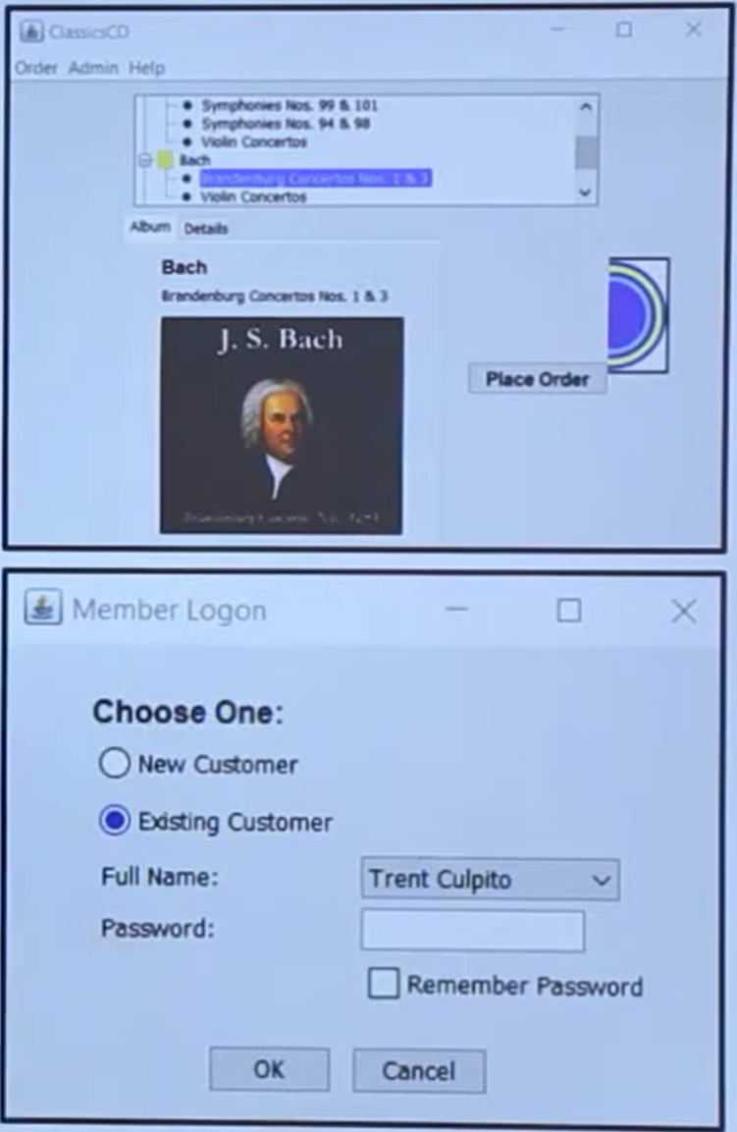
Spelling Mistake
Height of the text/input/select box
State of object (image)
Data Verification Point
Properties Verification Point
Get Specific Property Value
Image Verification Point
Wait for selected Test Object

Slide 4
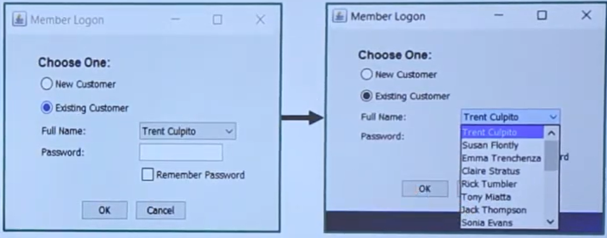
Data Verification Point (Check Point)
In every build the data may increase?

Slide 5
Regression testing is a type of software testing that ensures that previously developed and tested software still performs the same way after it is changed or interfaced with other software

Slide 6
Data Verification Point (Check Point)
When we go for data verification point here full name

Slide 7
With Data Verification Point
Record Script
Insert Data Verification point
End Recording
Replay (will pass)
Modify verification point
Replay (will fail)

Slide 8
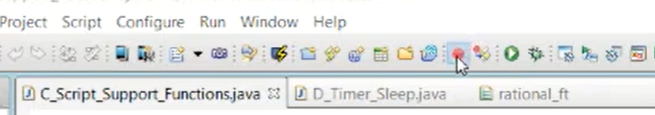
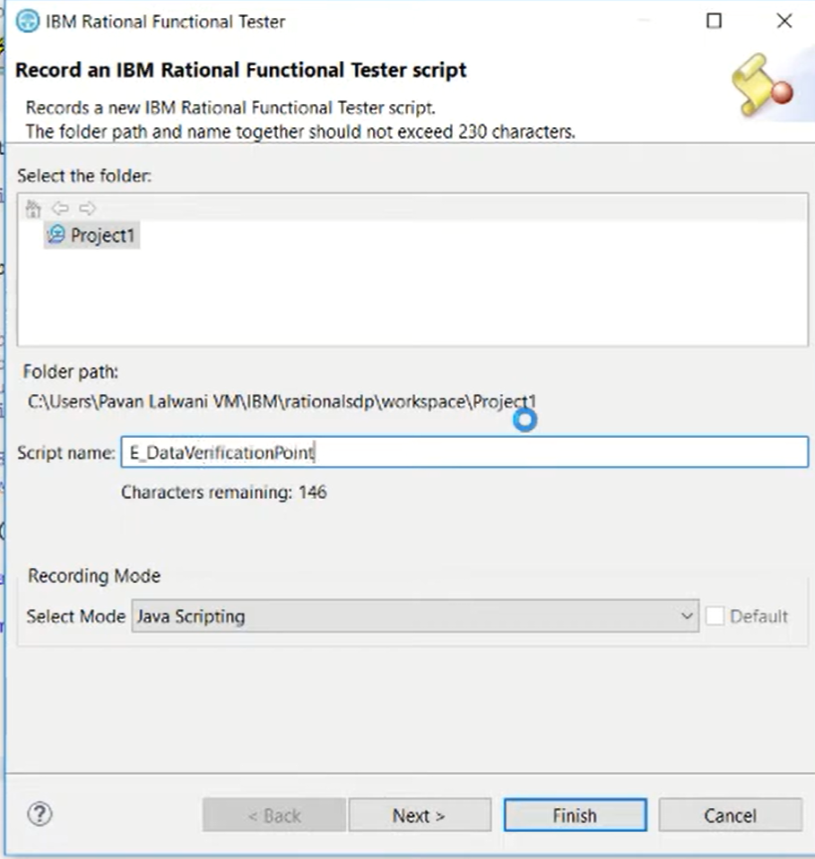

Slide 9
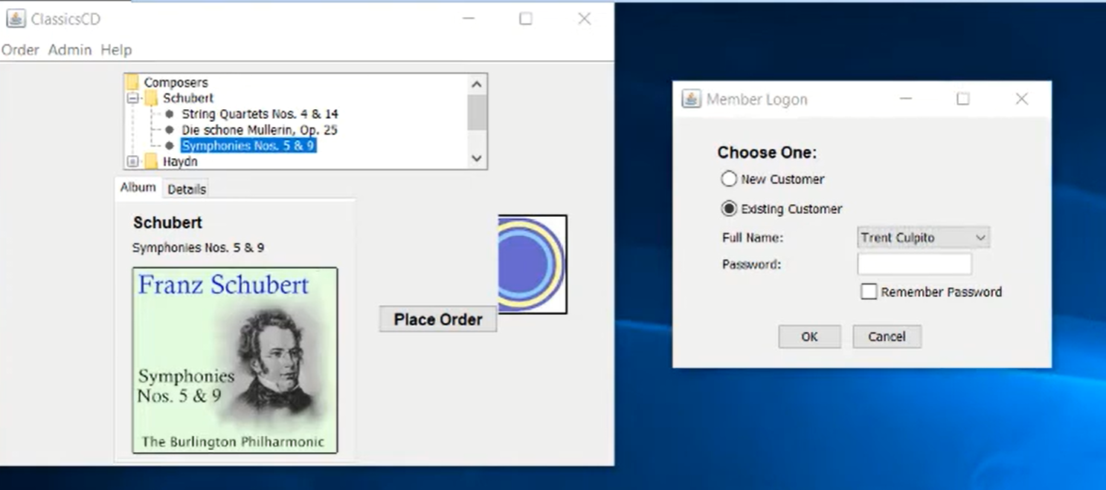
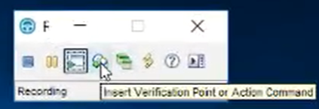

Slide 10
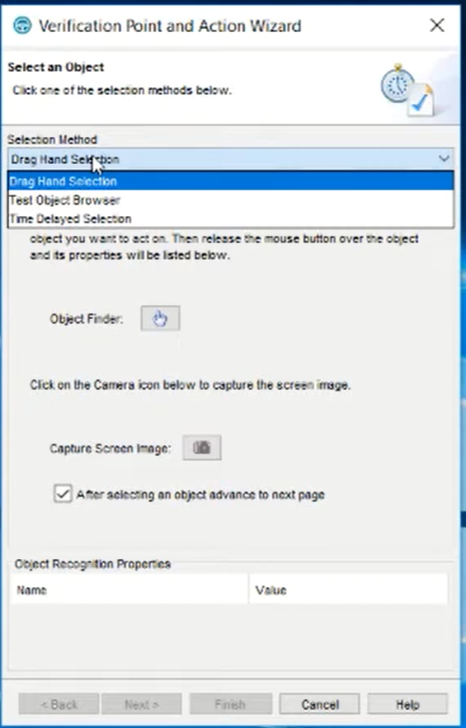

Slide 11
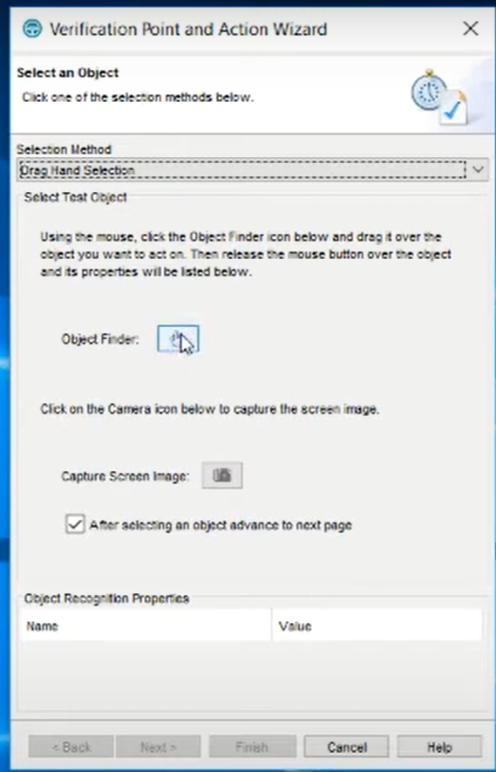
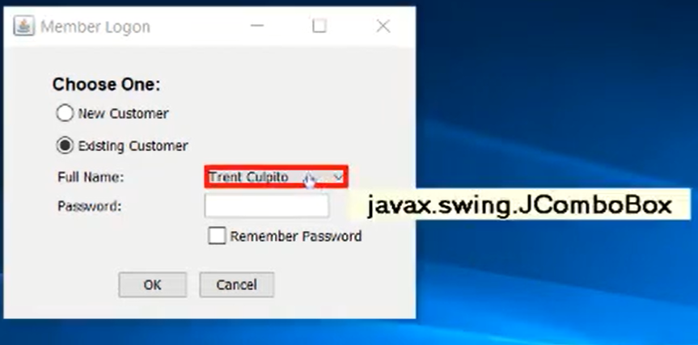

Slide 12
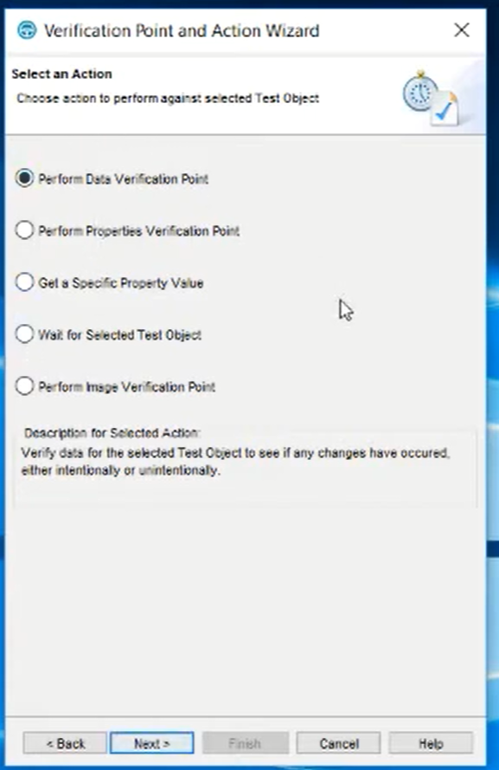
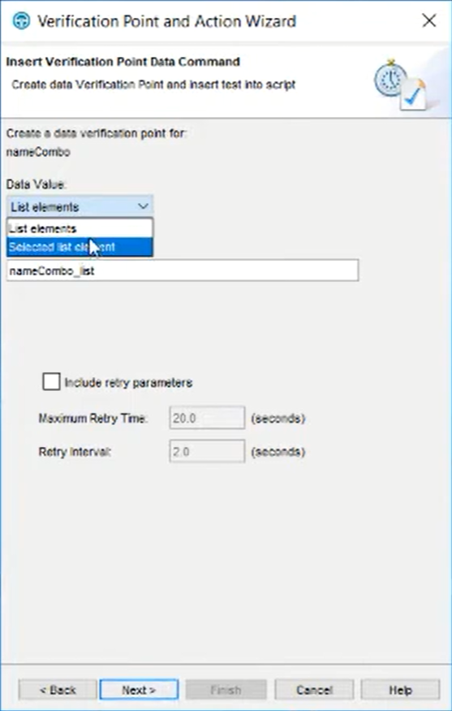
After the selection, we get next page to select type of verification

Slide 13
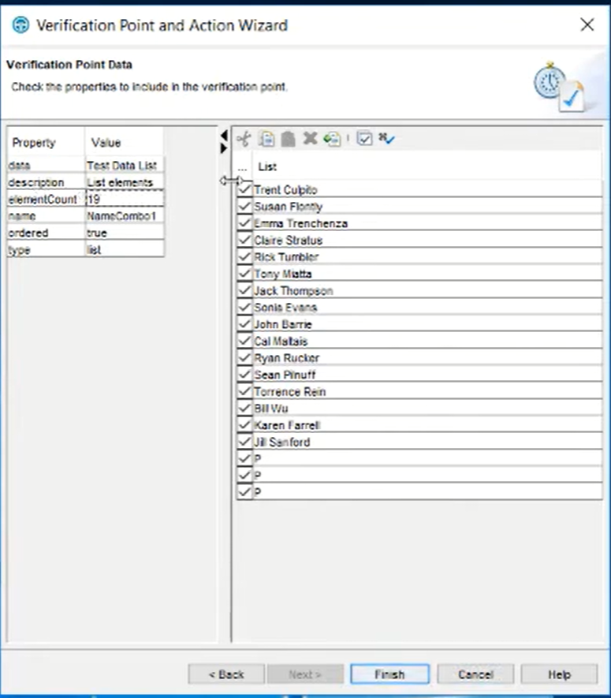
Finish and
Complete other steps of recording

Slide 14
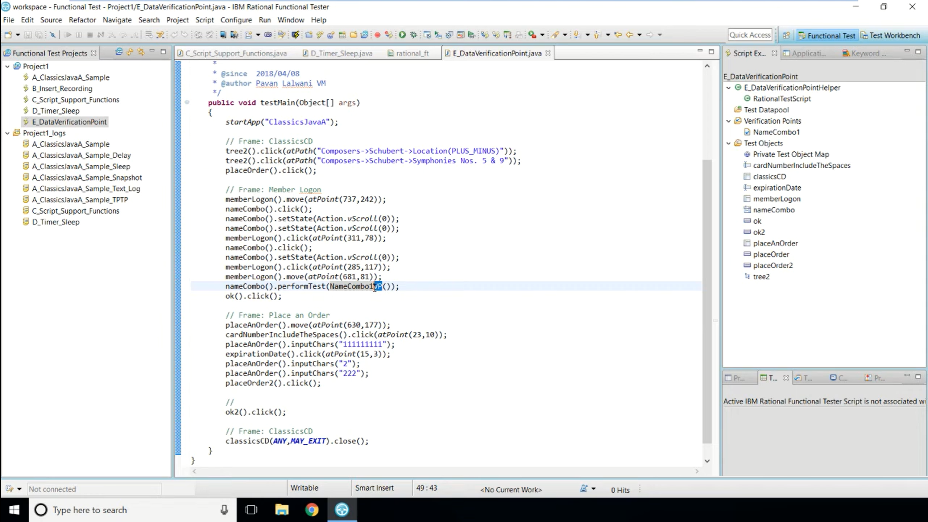

Slide 15
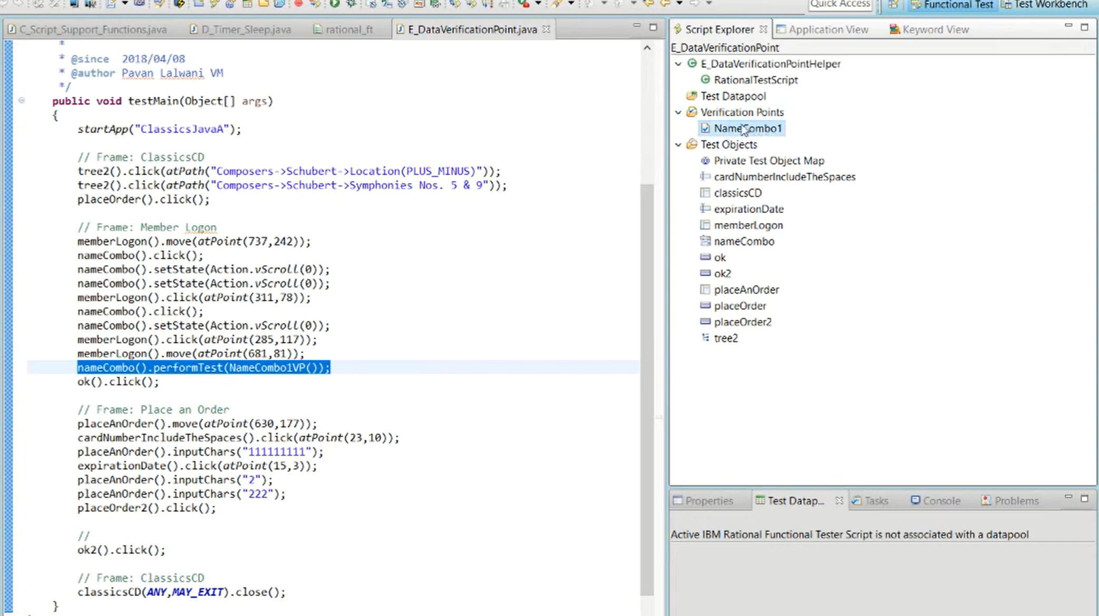

Slide 16
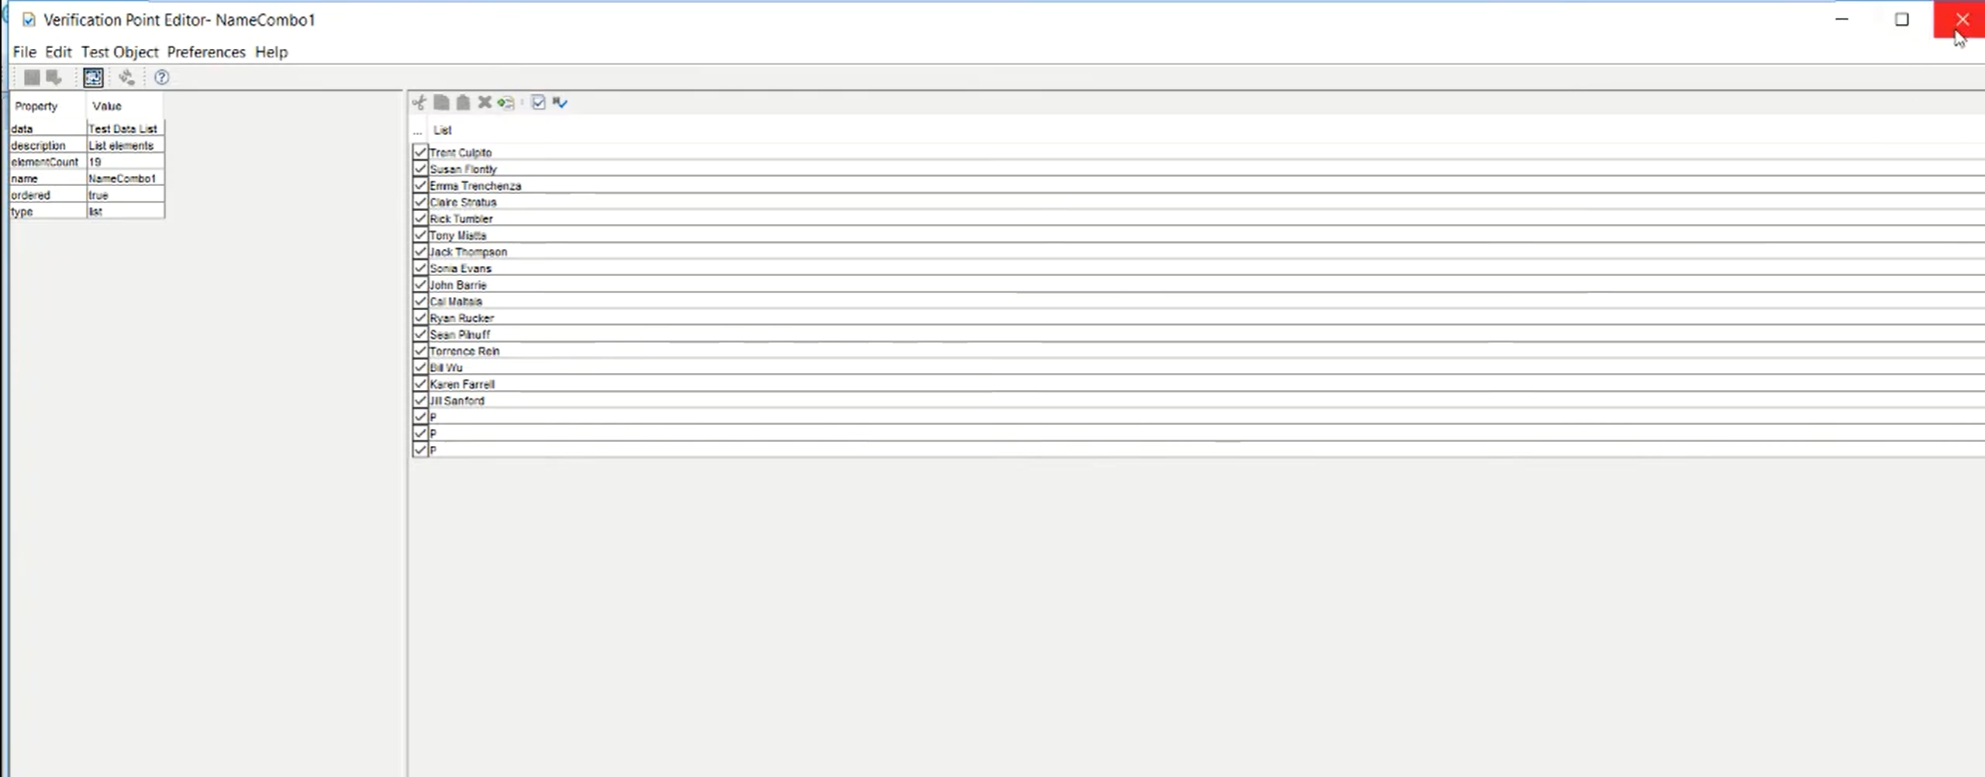
You can add / Modify the data here

Slide 17
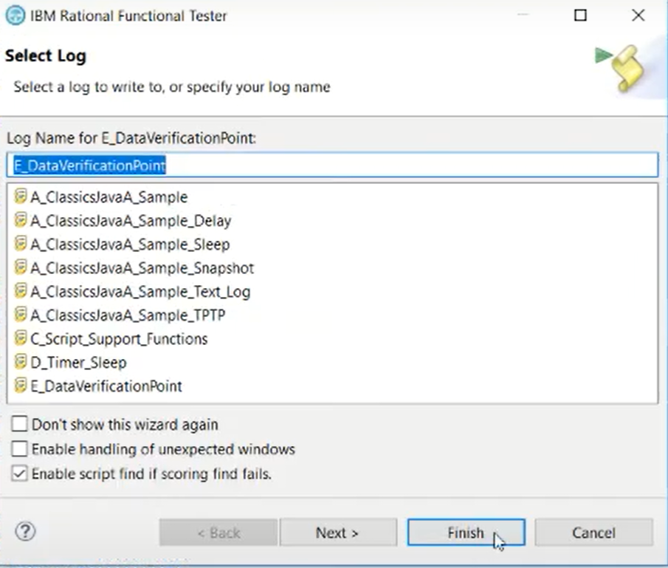
Start Play Back

Slide 18
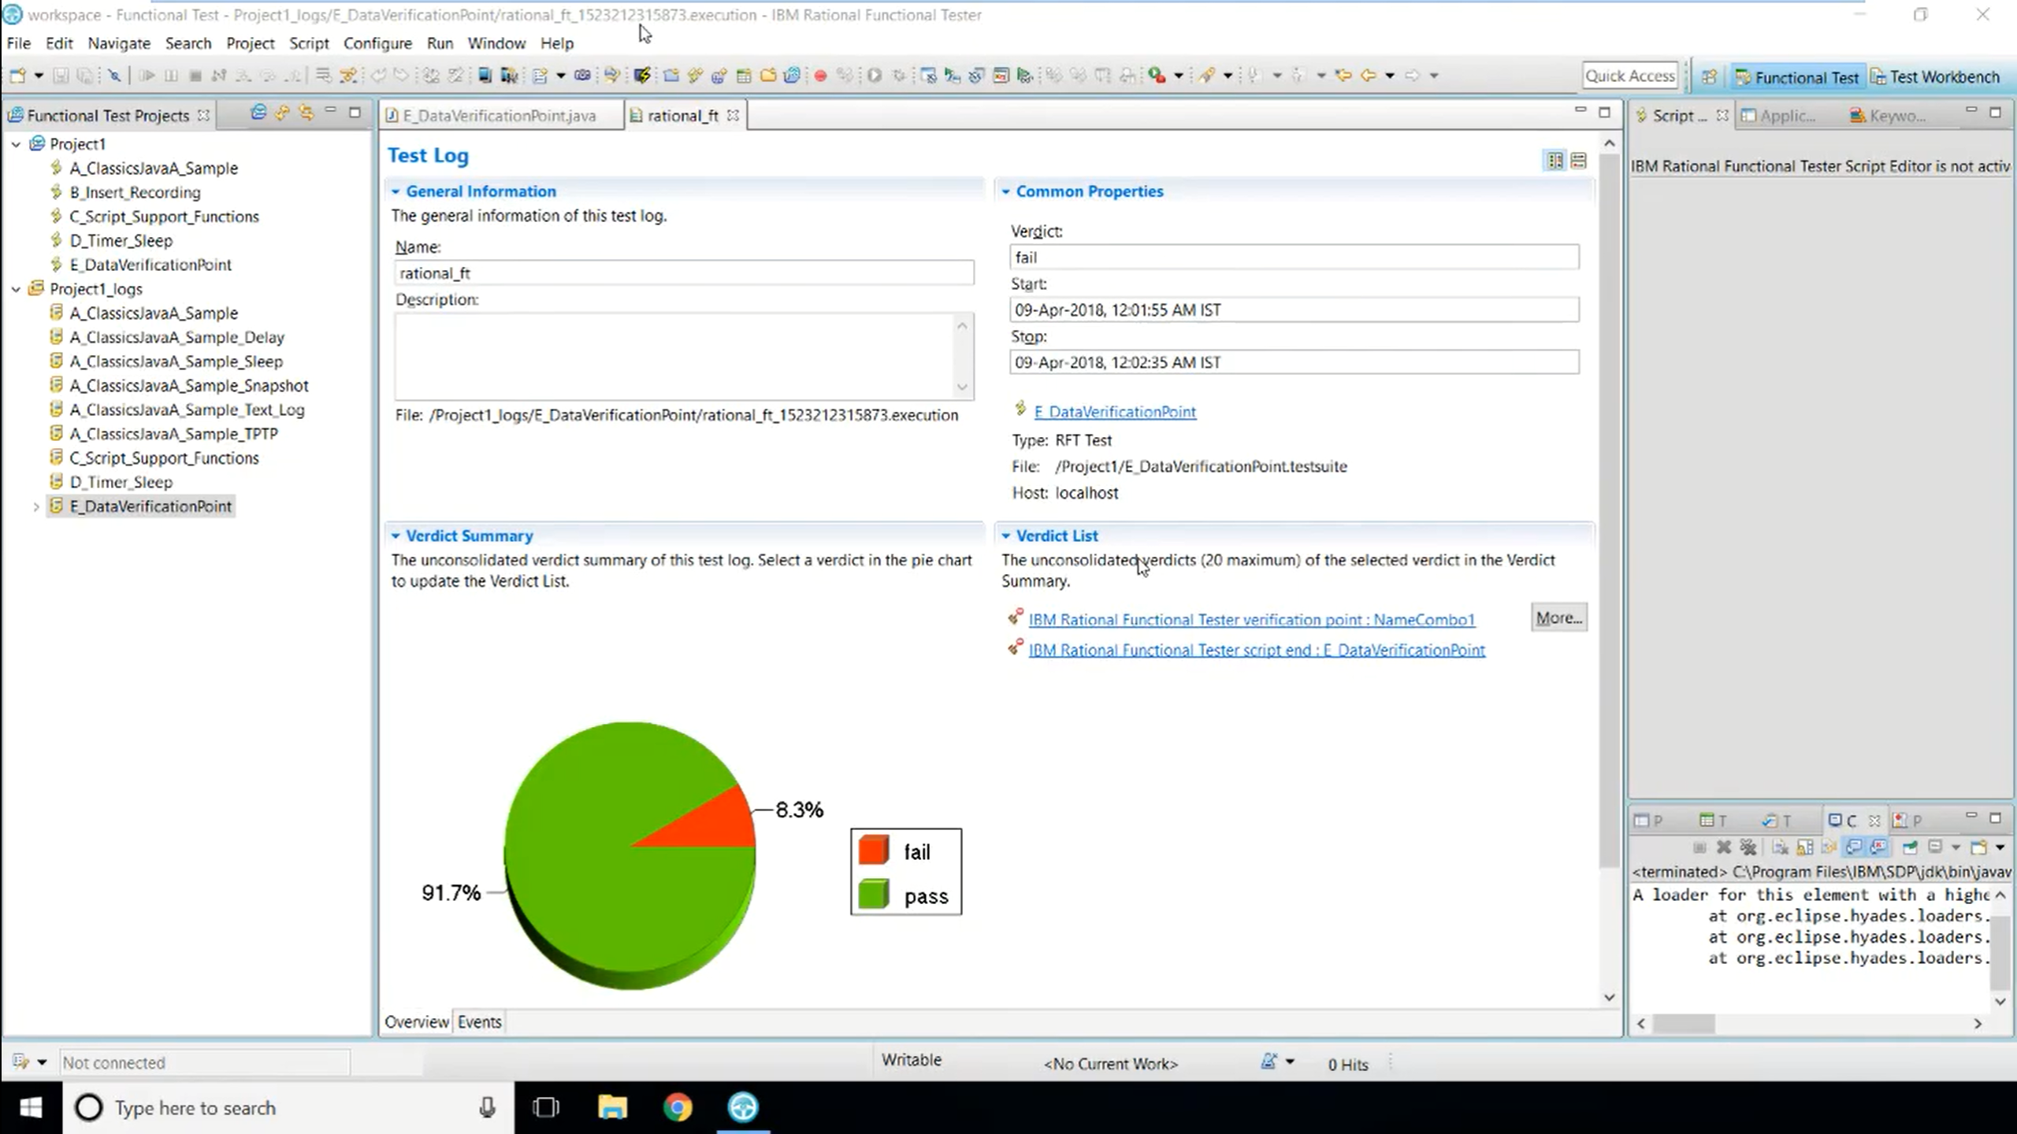

Slide 19
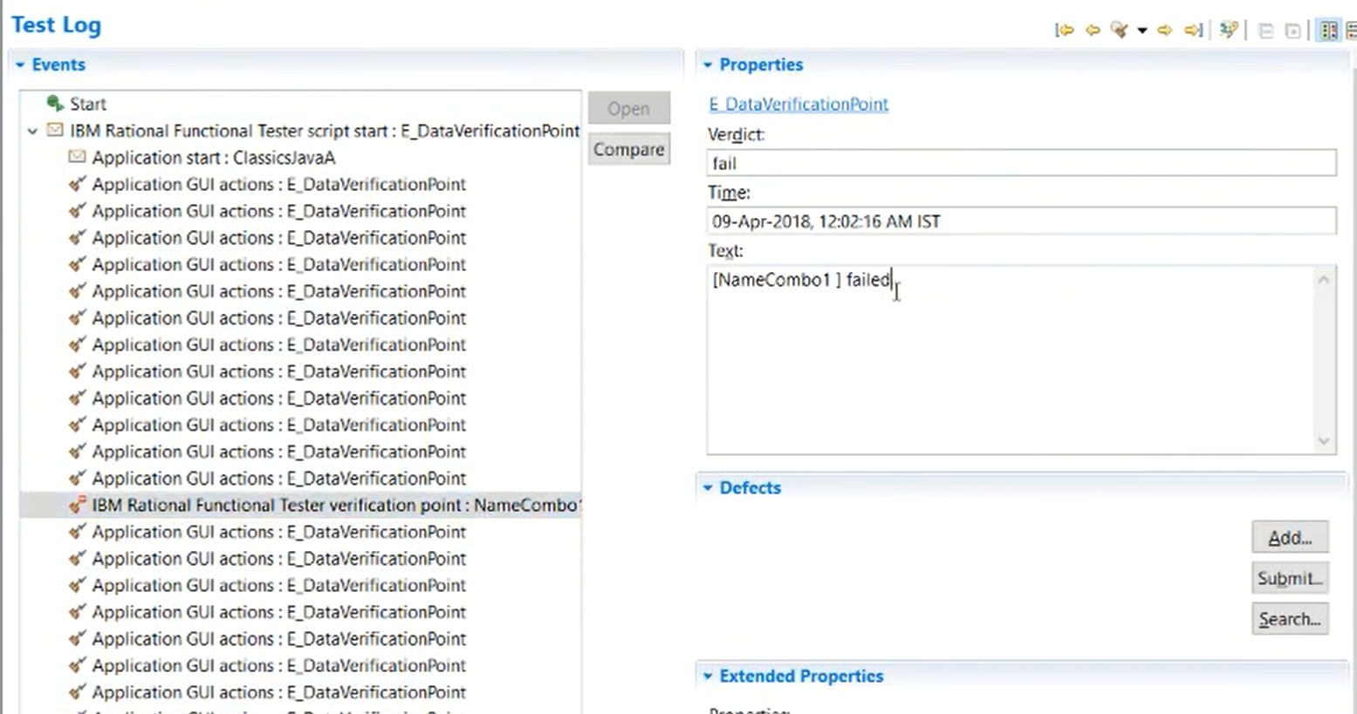

Slide 20
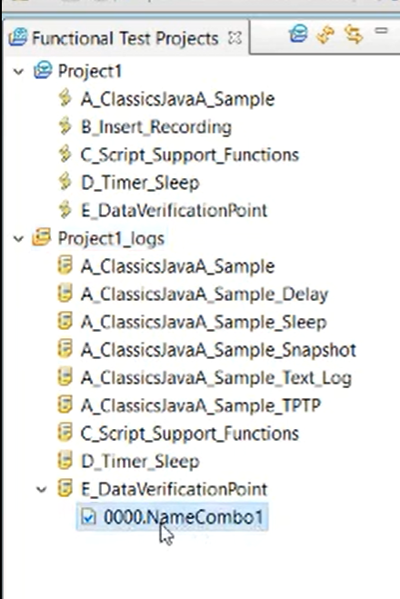
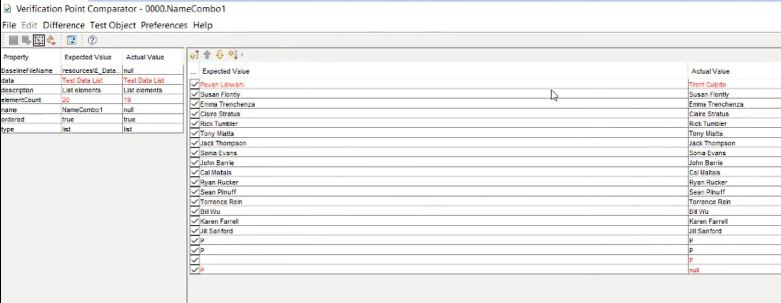
Verify the error/fail

Slide 21
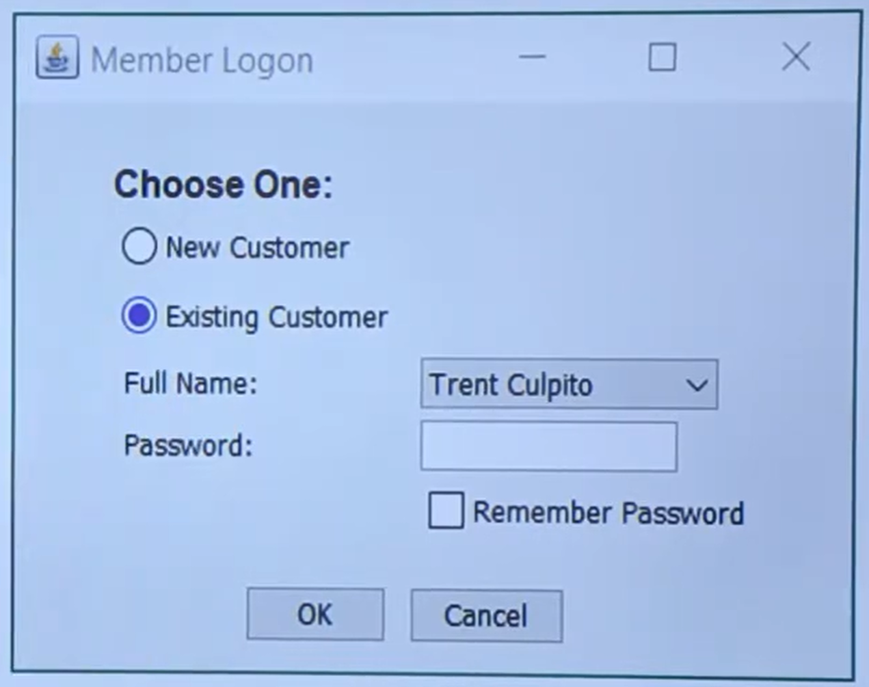
Property Verification Point
Styles like
Element height/width etc

Slide 22
With Property Verification Point
Record Script
Insert Data Verification point
End Recording
Replay (will pass)
Modify verification point
Replay (will fail)

Slide 23
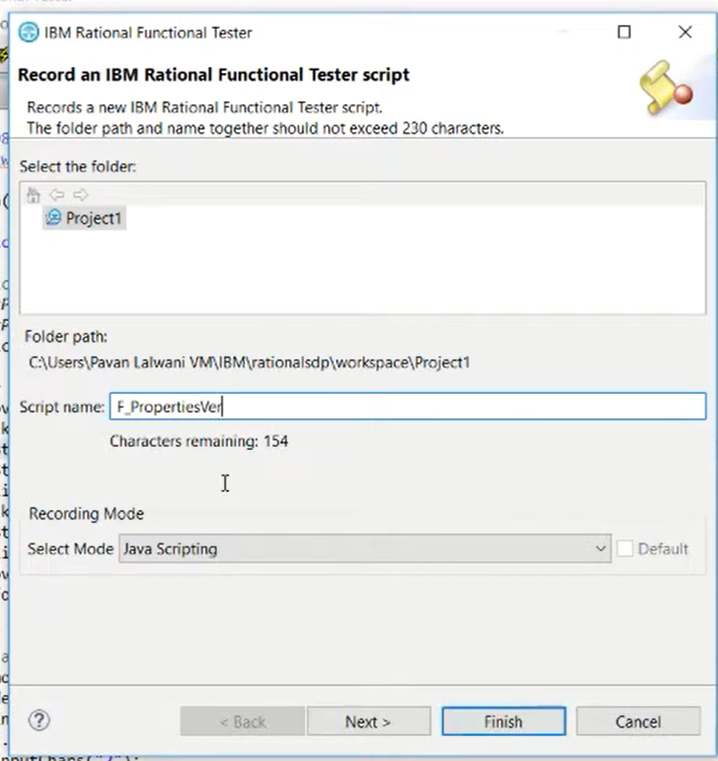
Start new recording

Slide 24
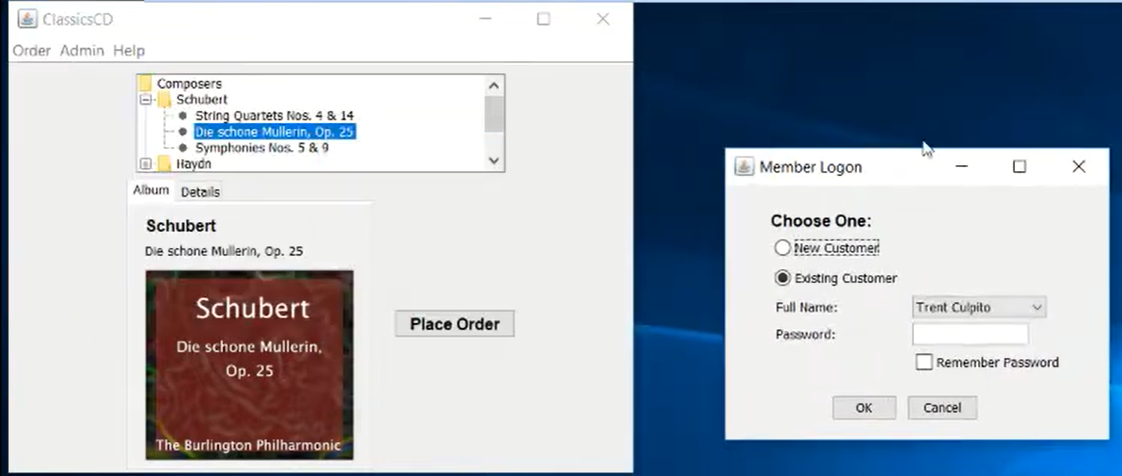

Slide 27
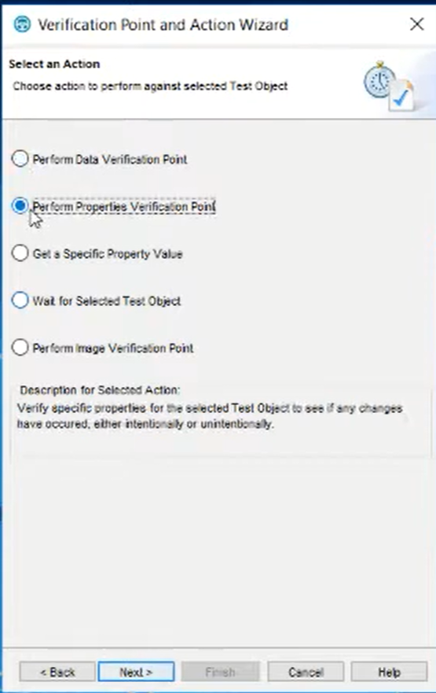
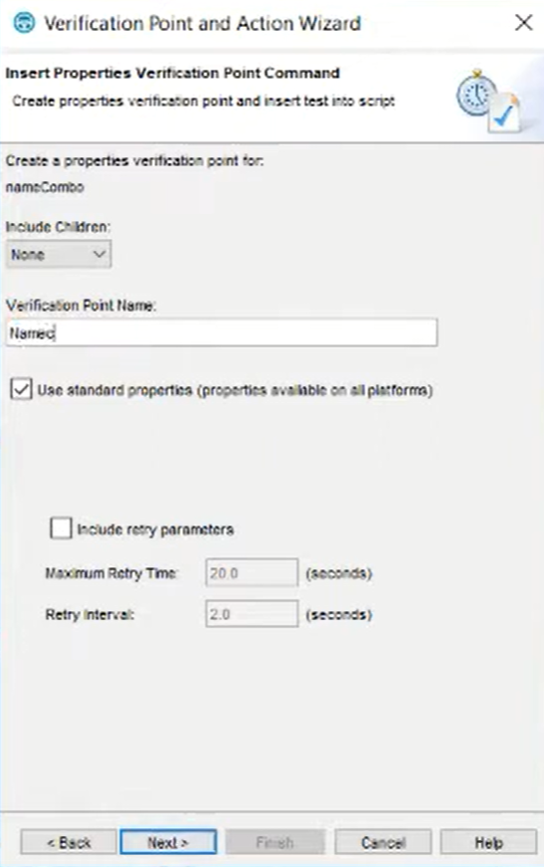

Slide 28
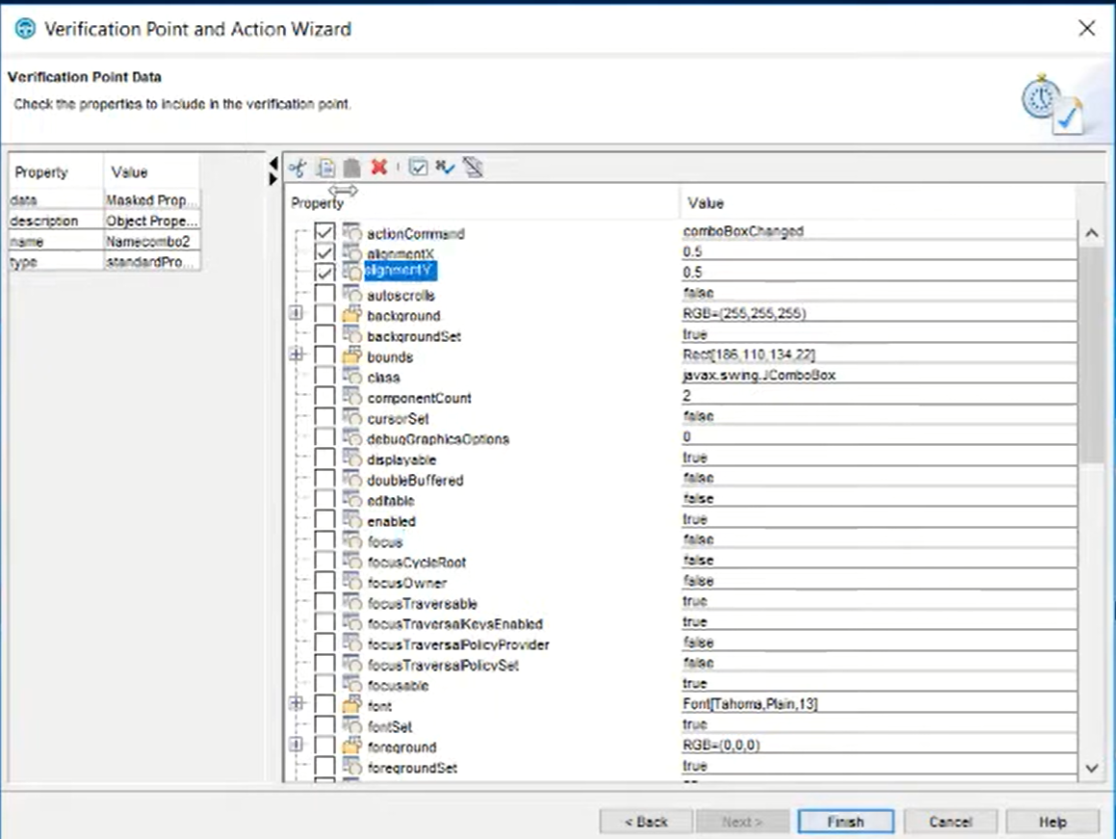

Slide 29
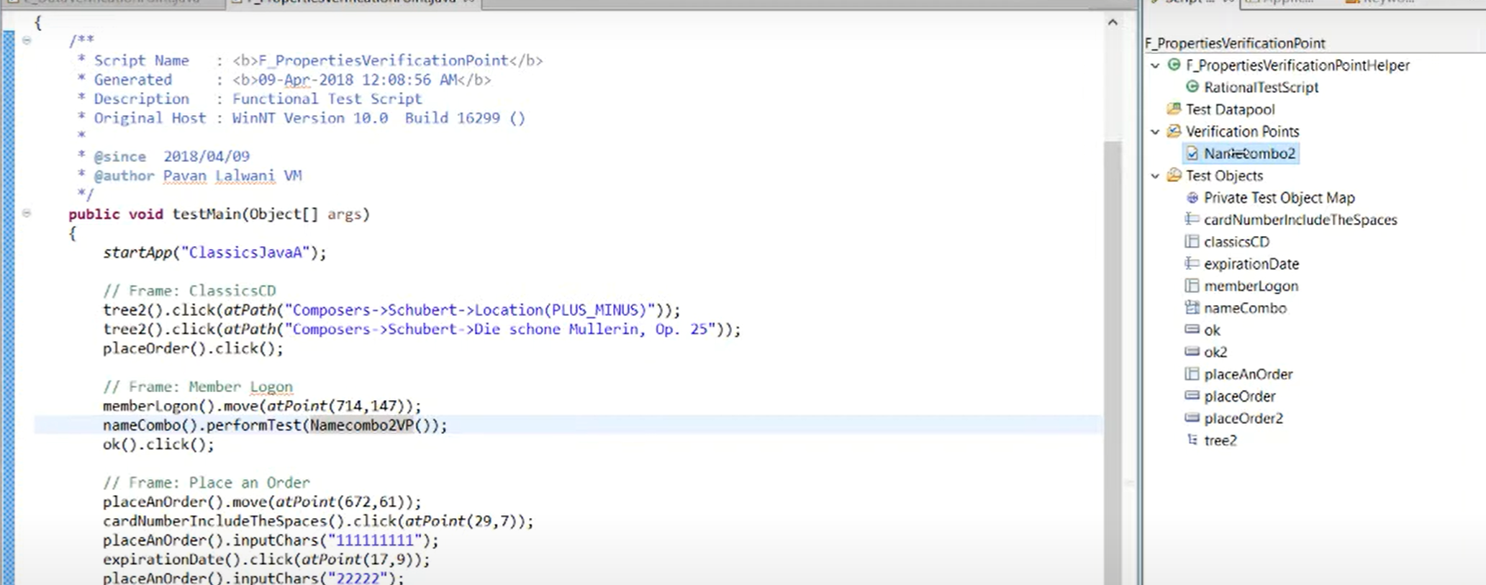
Generated Script after the record

Slide 30
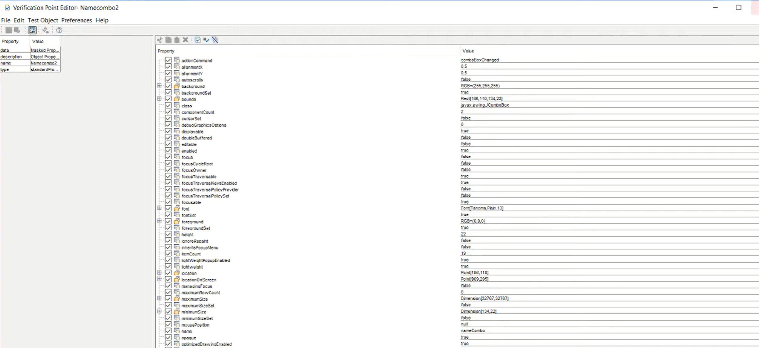

Slide 31
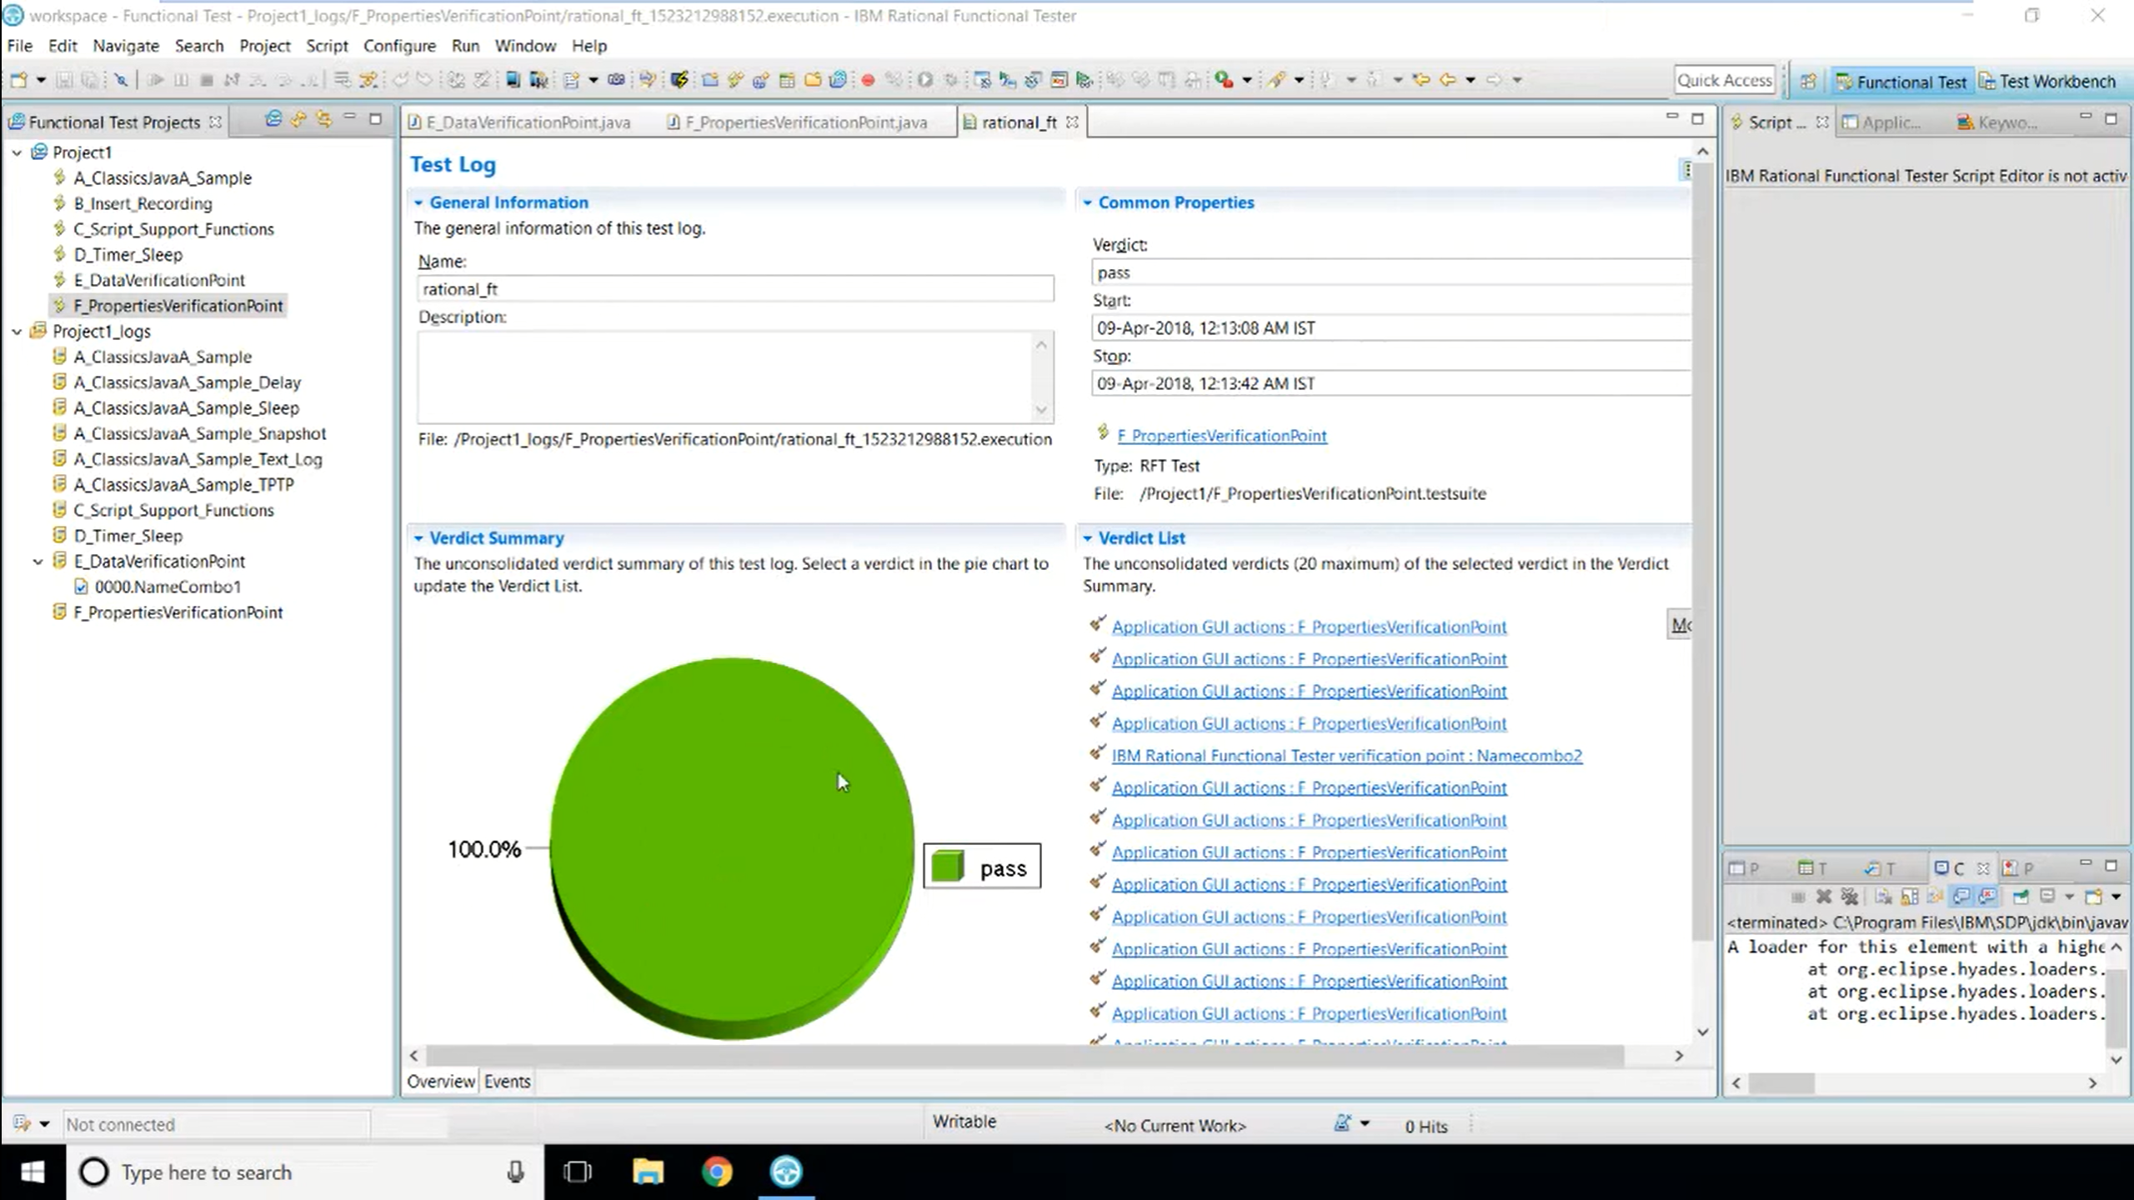

Slide 32
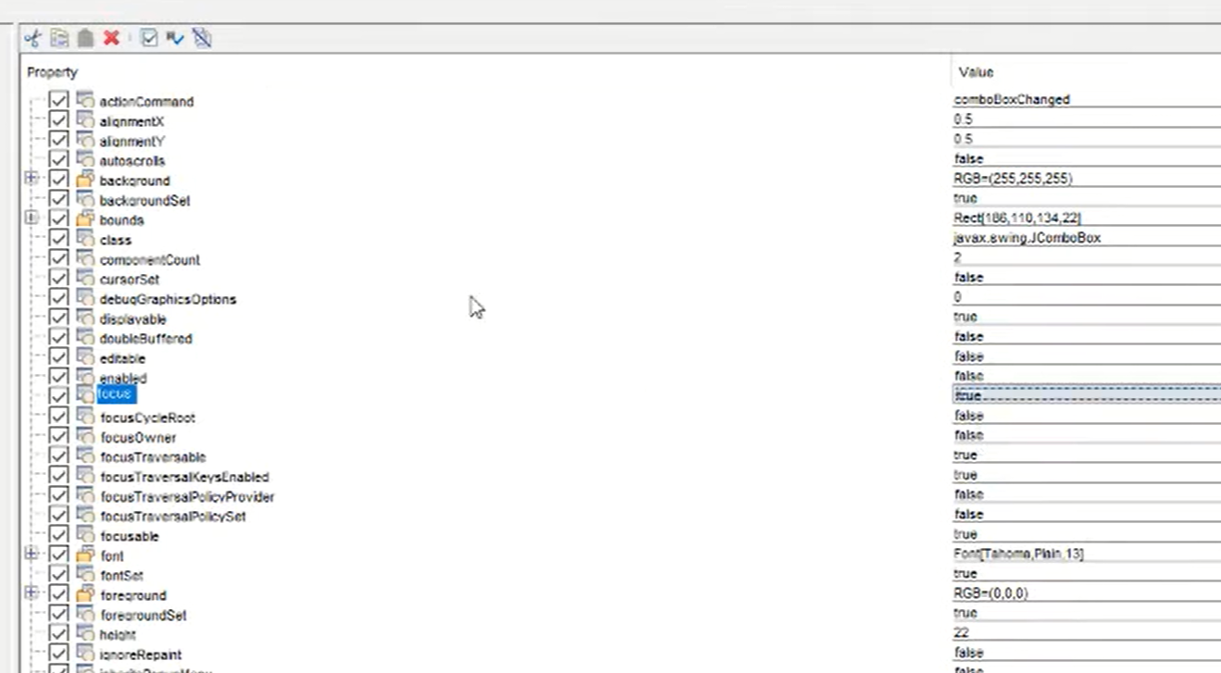
Modify property values

Slide 33
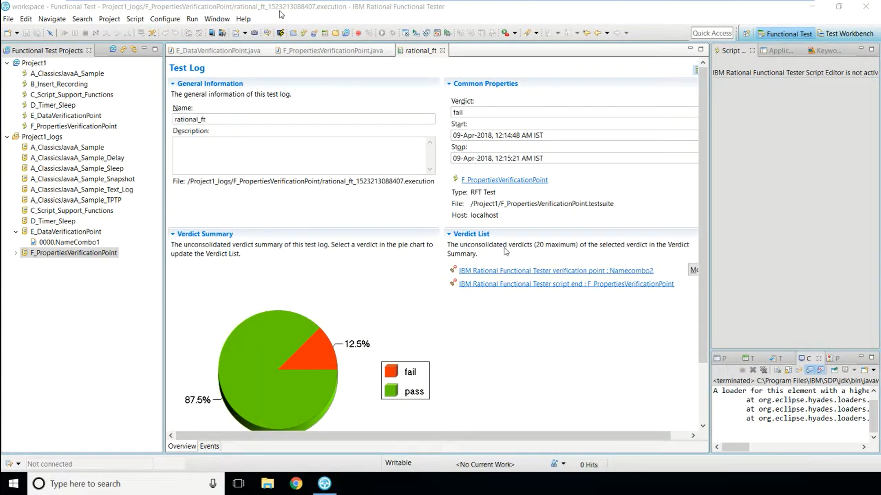

Slide 34
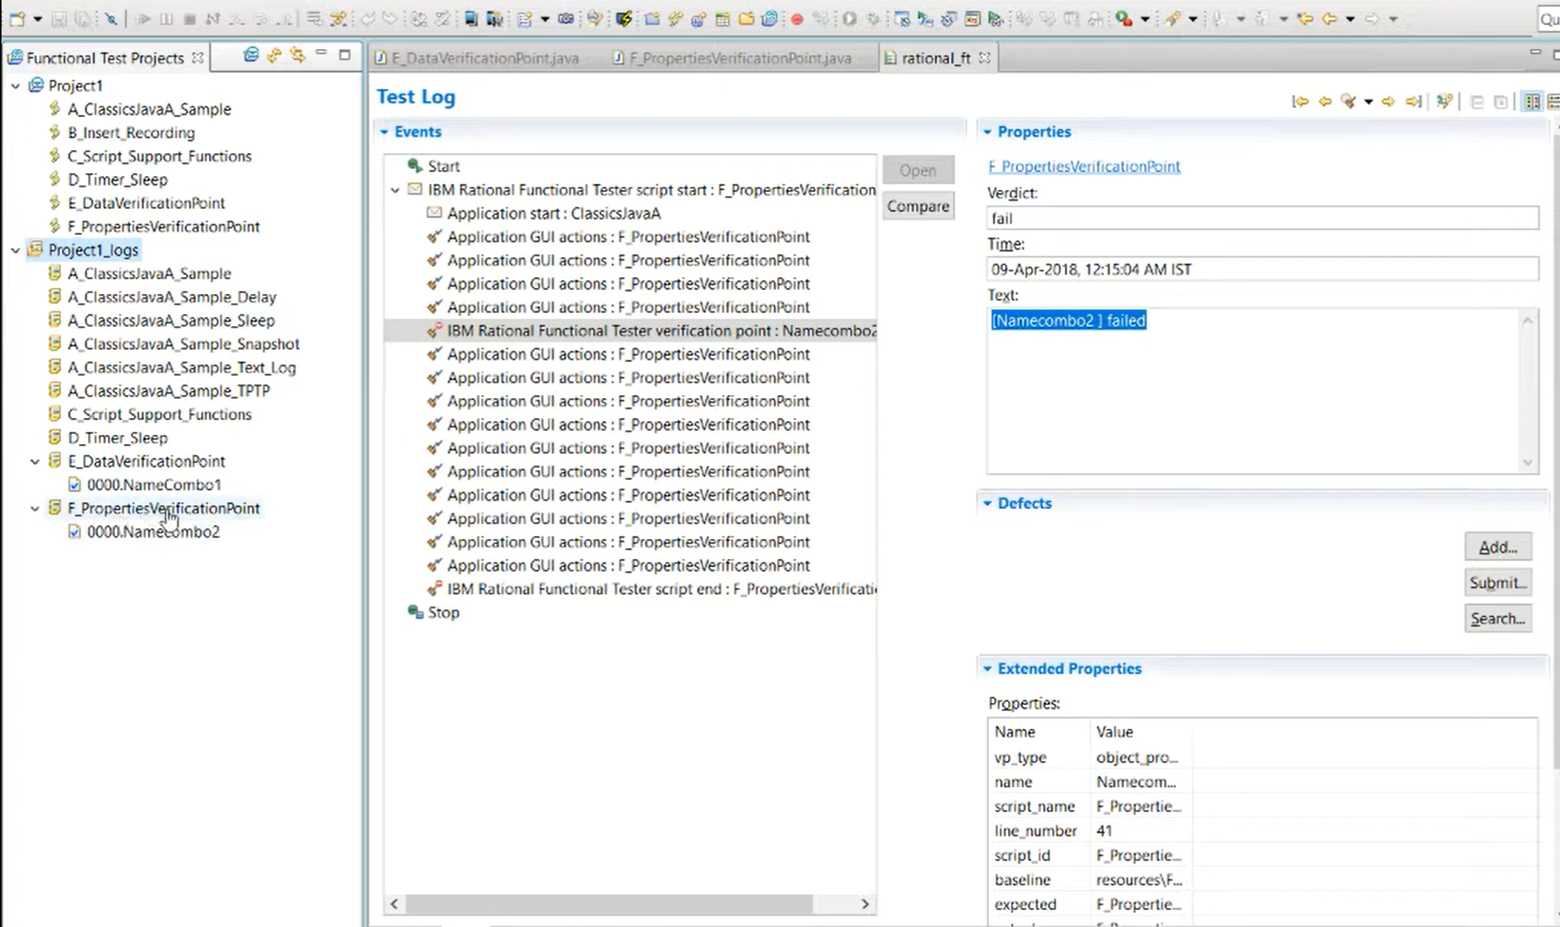

Slide 35
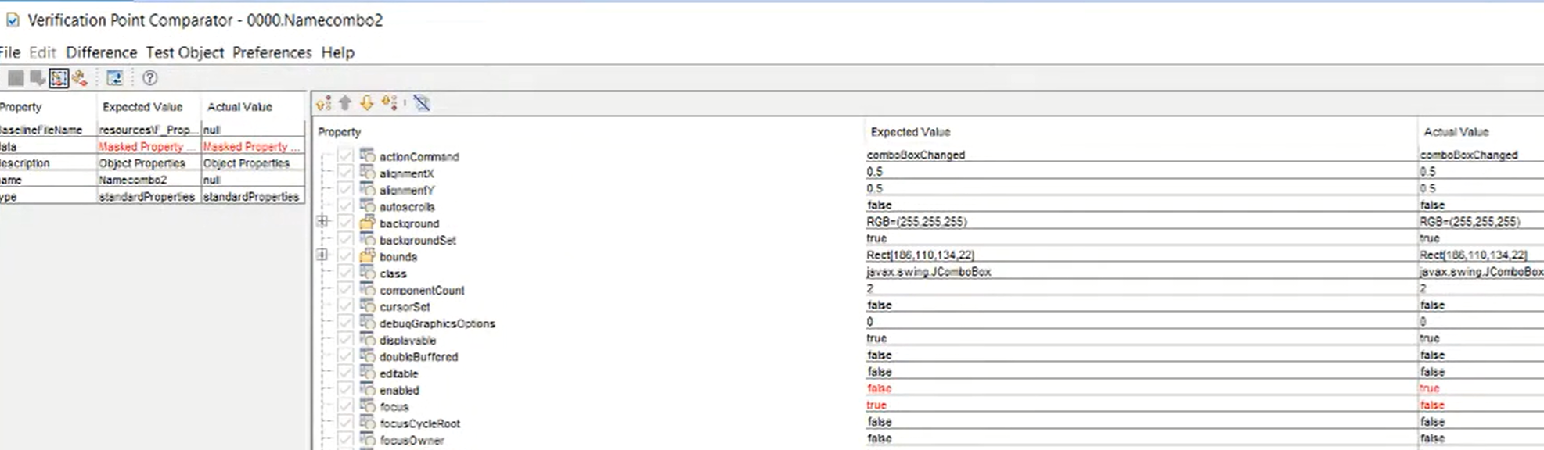
Analyze report

Slide 36
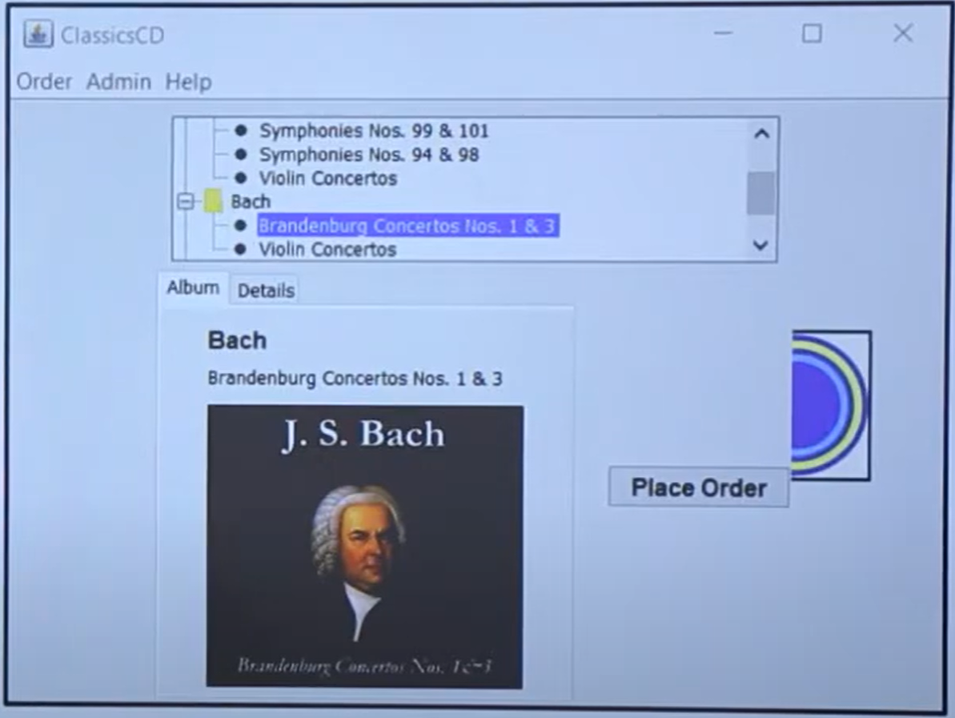
Image Verification Point

Slide 40
With Image Verification Point
Record Script
Insert Data Verification point
End Recording
Replay (will pass)
Modify verification point
Replay (will fail)

Slide 41
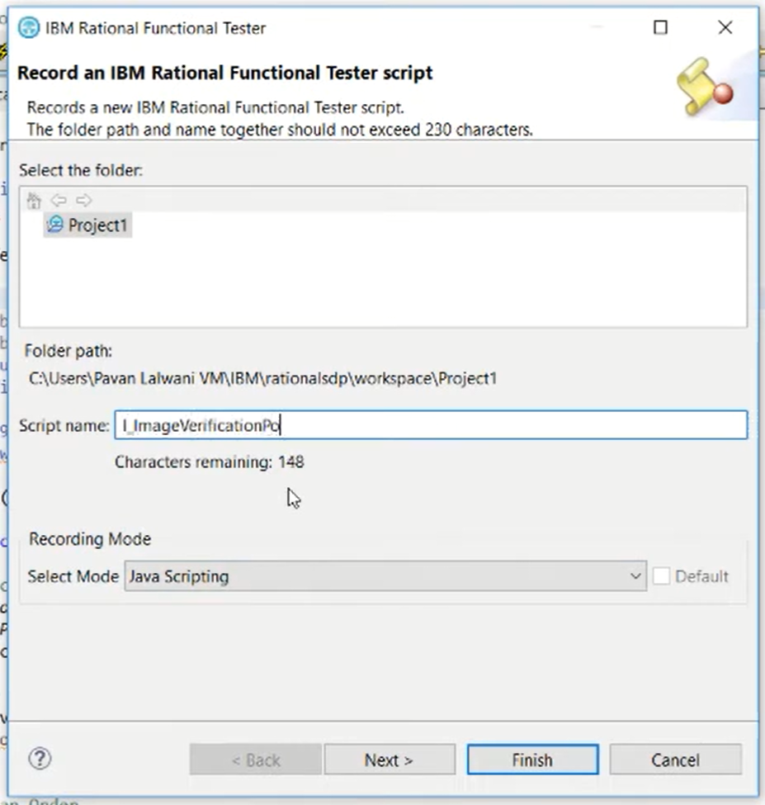

Slide 43
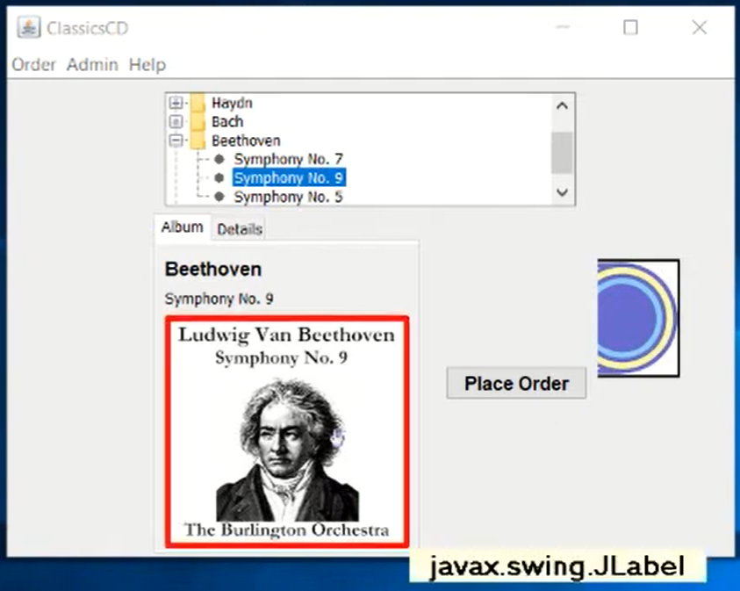

Slide 44
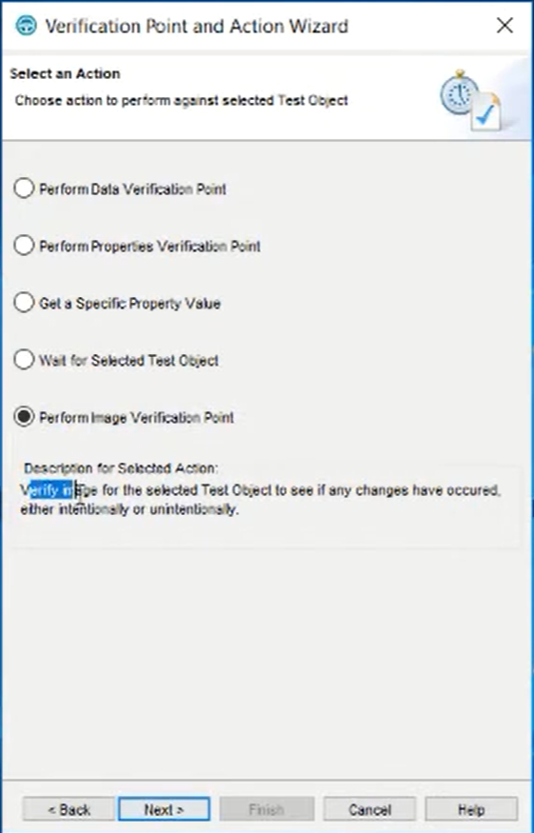
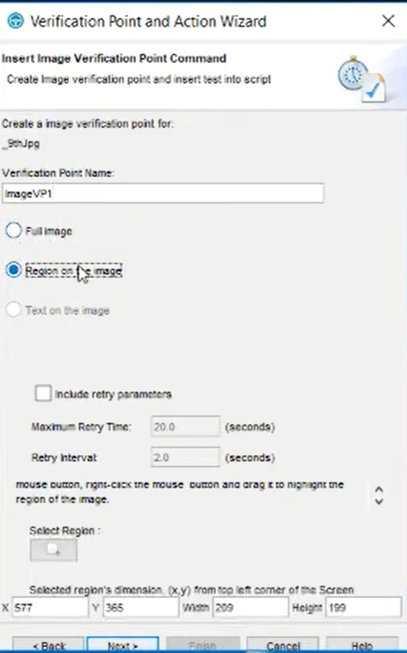

Slide 45
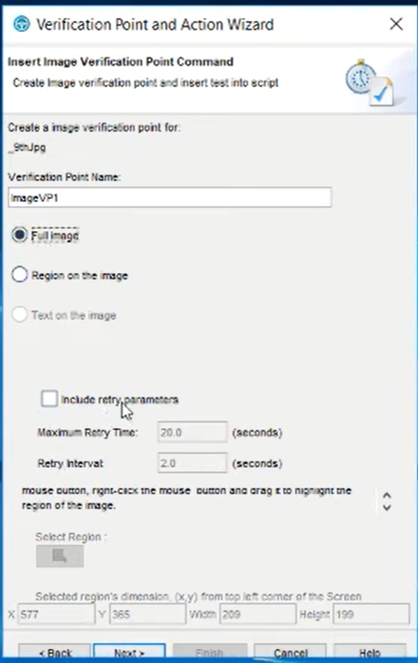
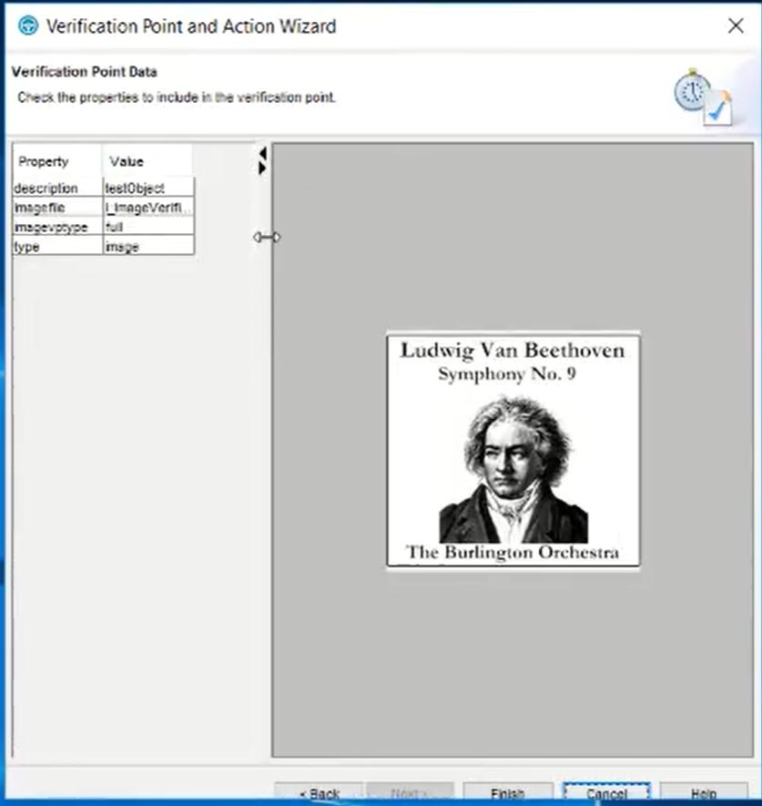

Slide 46
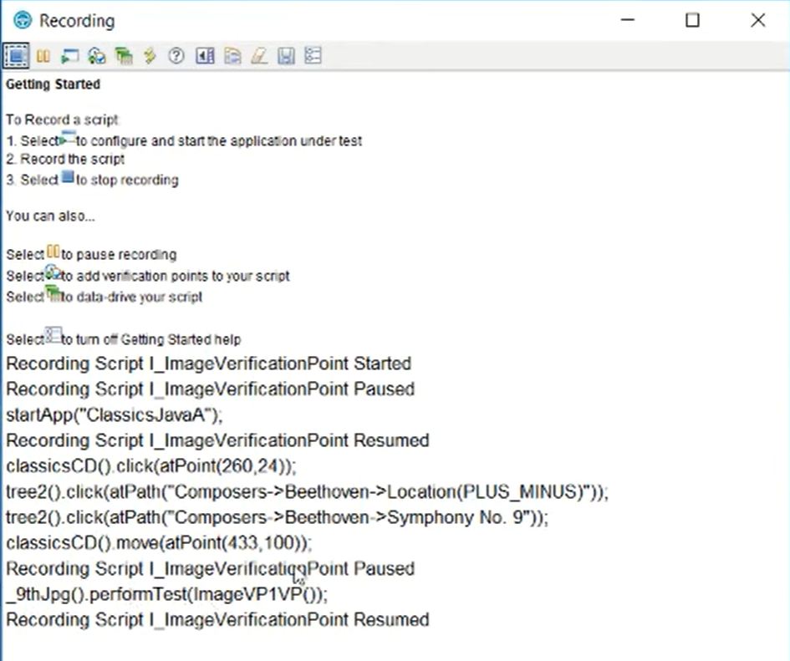
If you expand the recording
Window , we can see
scripts

Slide 47
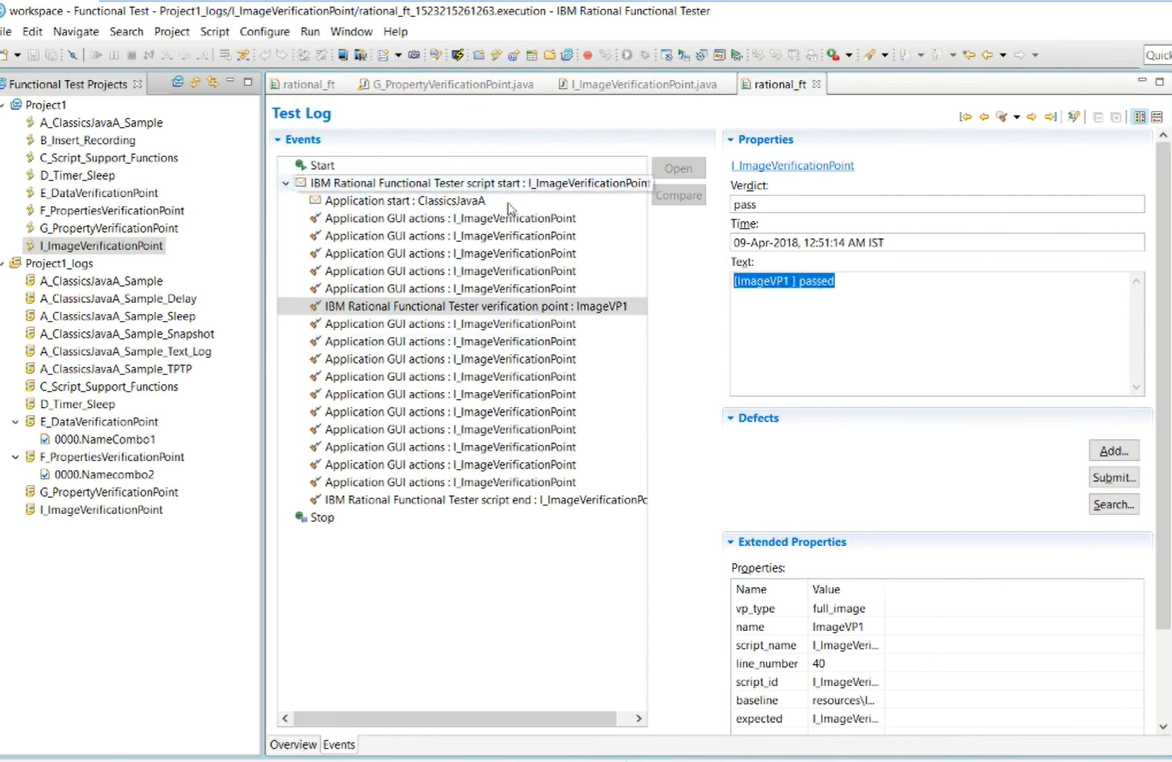

Slide 48
Wait for Selected Test Object
Record Script
insert Wait Command
End Recording

Slide 49
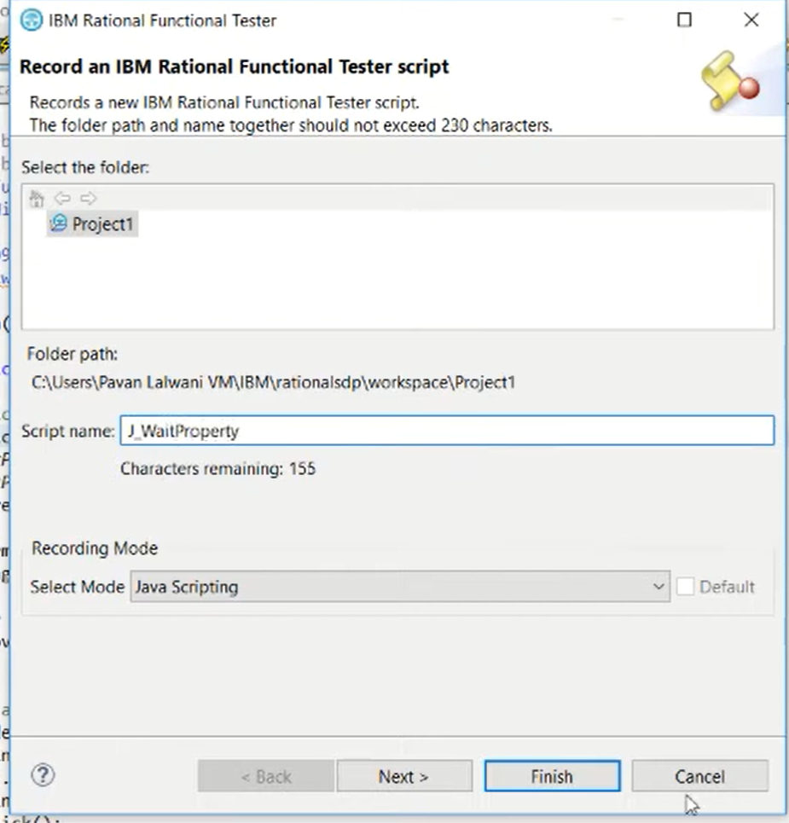

Slide 50
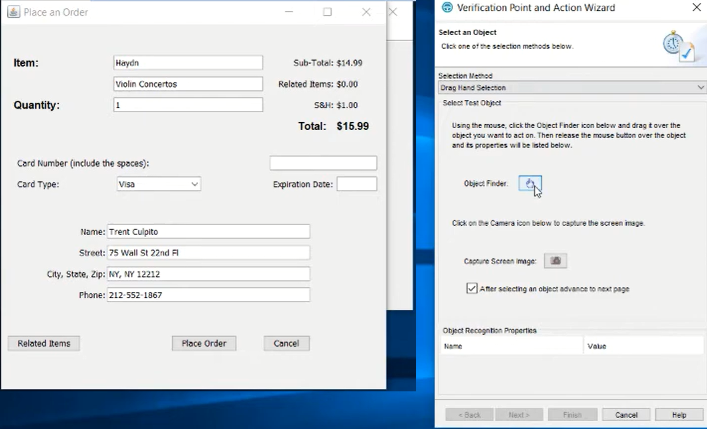

Slide 51
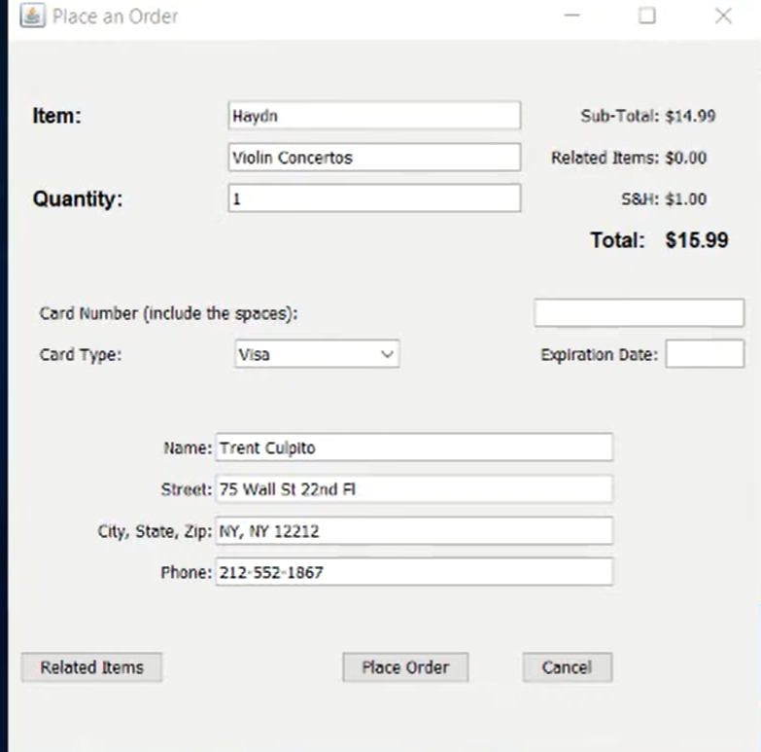
This time select
Entire dialogue Box

Slide 52
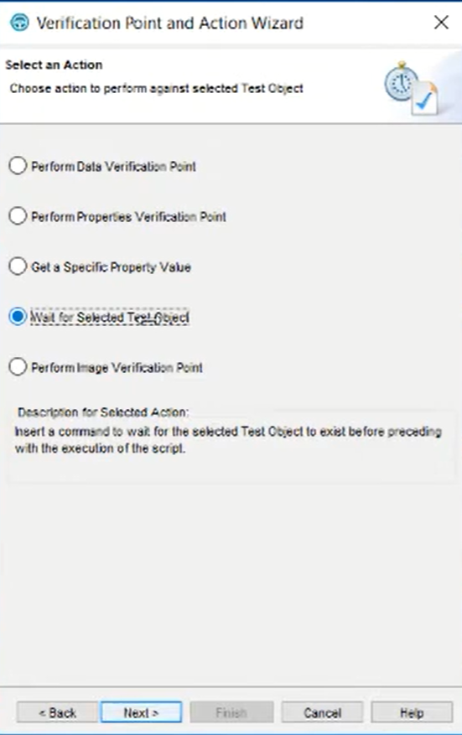
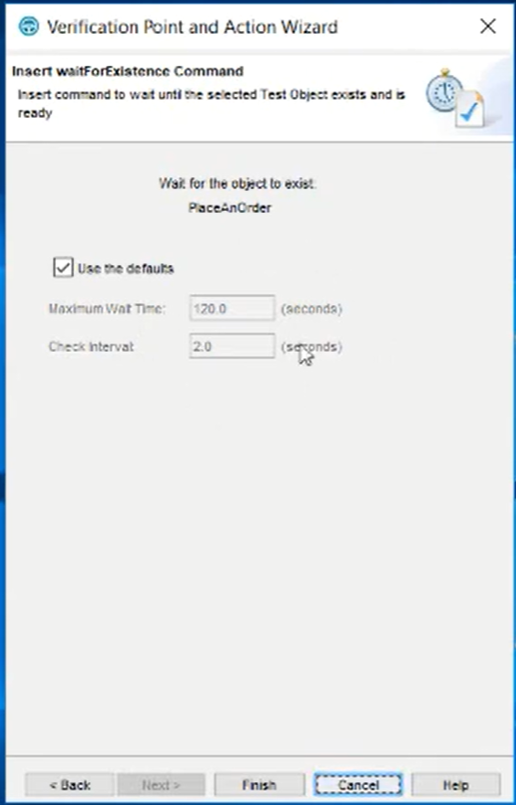

Slide 53
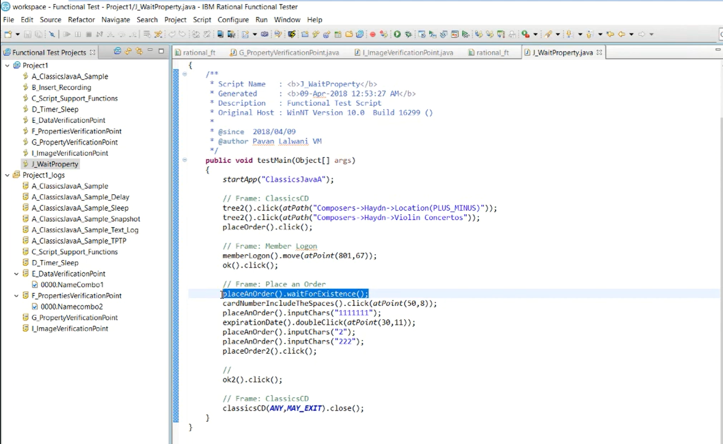

Slide 54
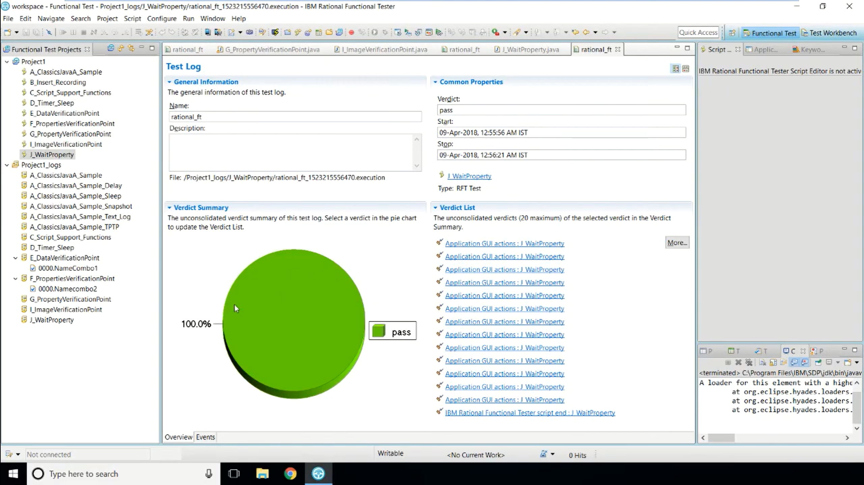

Slide 55
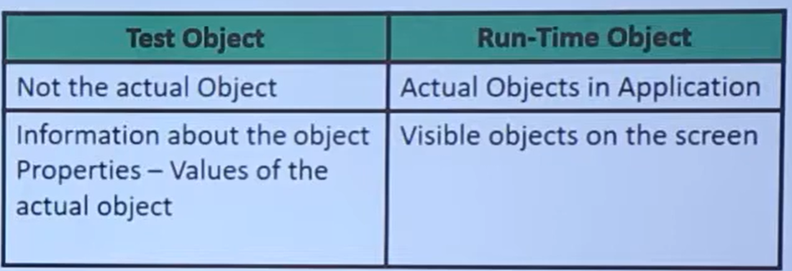
Test Object & Test Object Map

Slide 56


Slide 57


Slide 58
Test Object Map
Hierarchical collection of description of test objects
It contains properties (Name-value) pairs for each test object
Display Test Object Map
Record new script
Open the Test Object Map
View Hierarchy and the test Objects
See the reference in the script

Slide 59


Slide 60


Slide 61

Complete the regular steps
And record

Slide 62


Slide 63


Slide 64


Slide 65

Data Driven Test
When you want to separate test scripts from test input data
When you want to repeat test with different data

Slide 66


Slide 67
Data Pool
Its a collection of data records
Data pool supplies data to the variables in the test script during playback
Create Data Driven Test
Record a script
Add Descriptive Names to Variables
Add Data To Data pool
Playback Script

Slide 68


Slide 69


Slide 70

Drag to any field

Slide 71


Slide 72


Slide 73


Slide 74

Edit
Modify
Delete
Data and variables

Slide 75


Slide 76


Slide 77

Click on Run Button to play the script

Slide 78


Slide 79


Slide 80


Slide 81



Slide 82


Slide 83
Either you can select datapool
Sheet from any specific source or
Go back and leave it with any
Specific name
It will create empty datapool

Slide 84


Slide 85


Slide 86

Import Data into Data Pool

Slide 87

Associate Data Pool with Scripts

Slide 88


Slide 89


Slide 90


Slide 91


Slide 92
Questions ???

